Slide 1
Kindness Rock

Slide 2
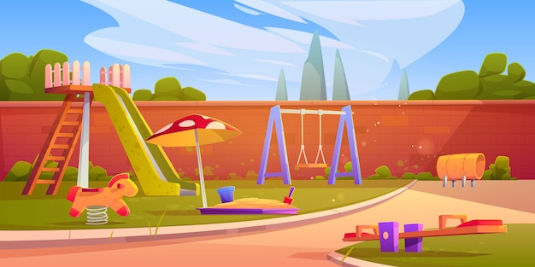
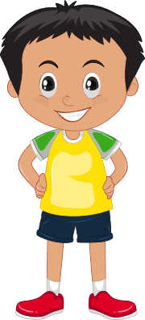
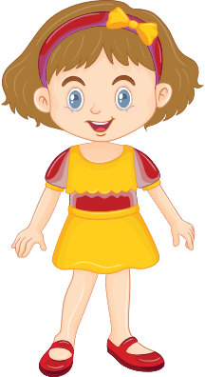
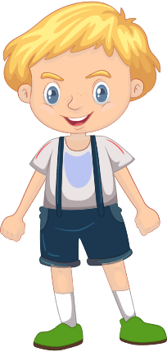
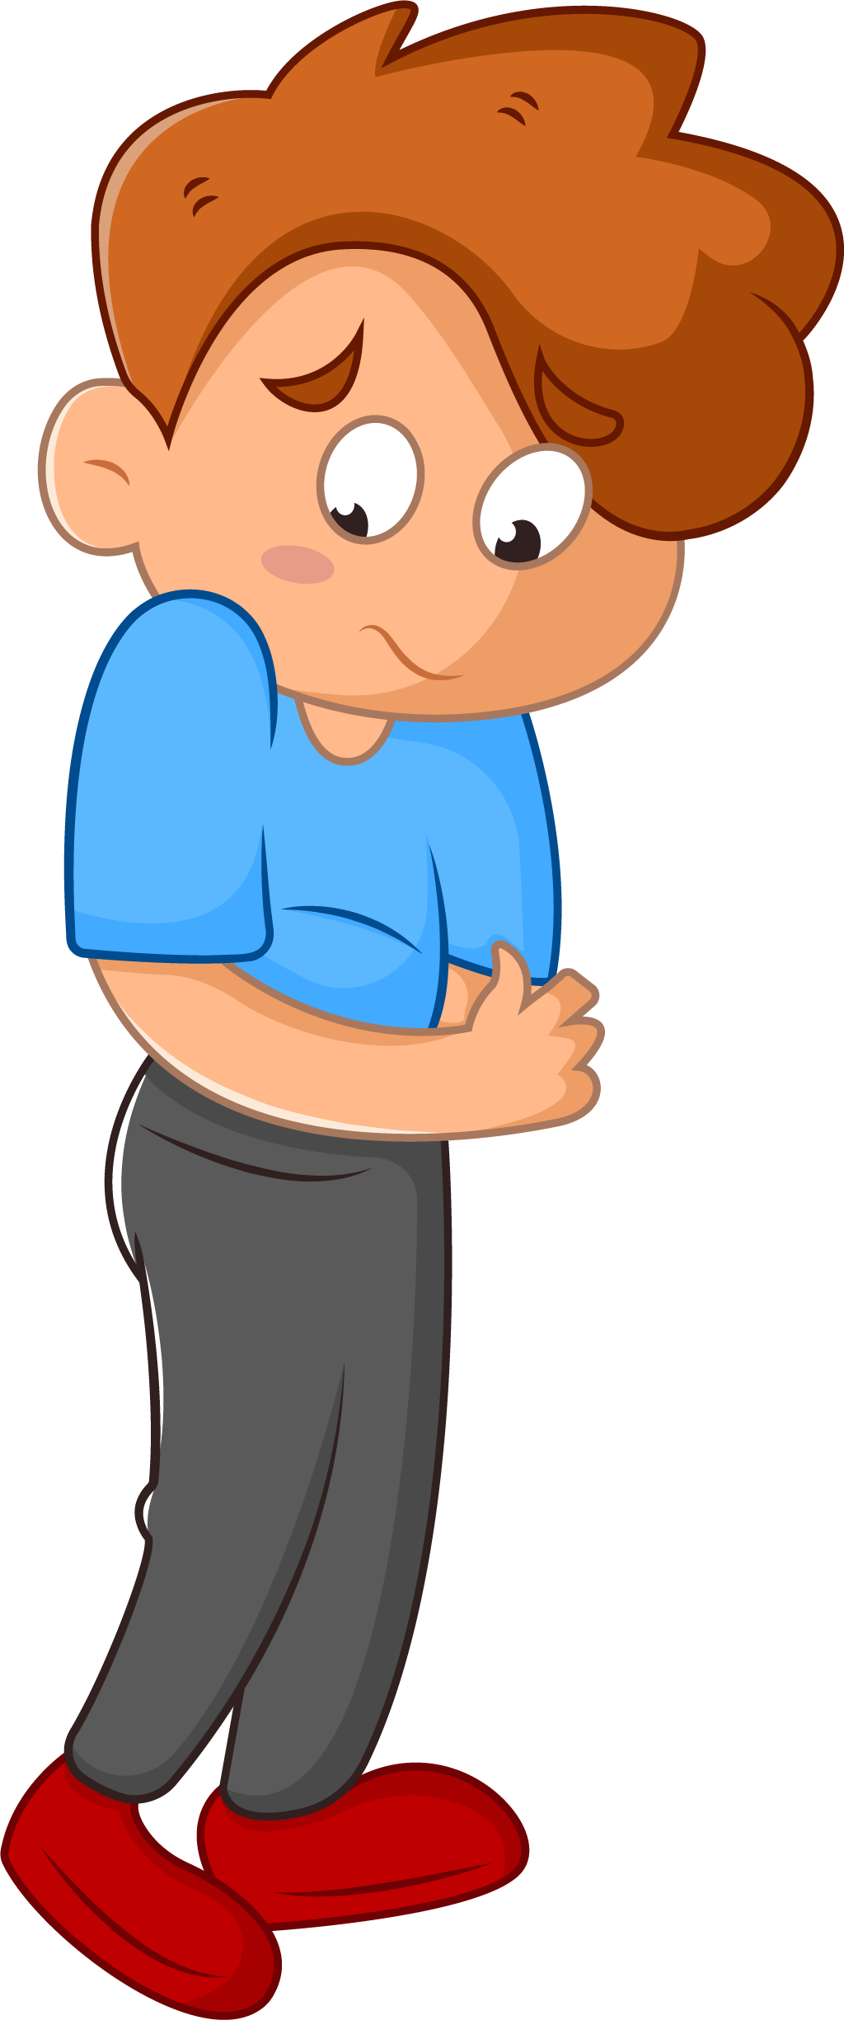
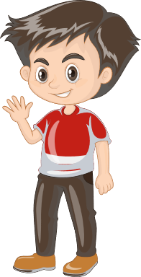
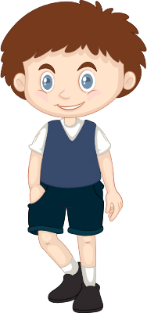

Slide 3
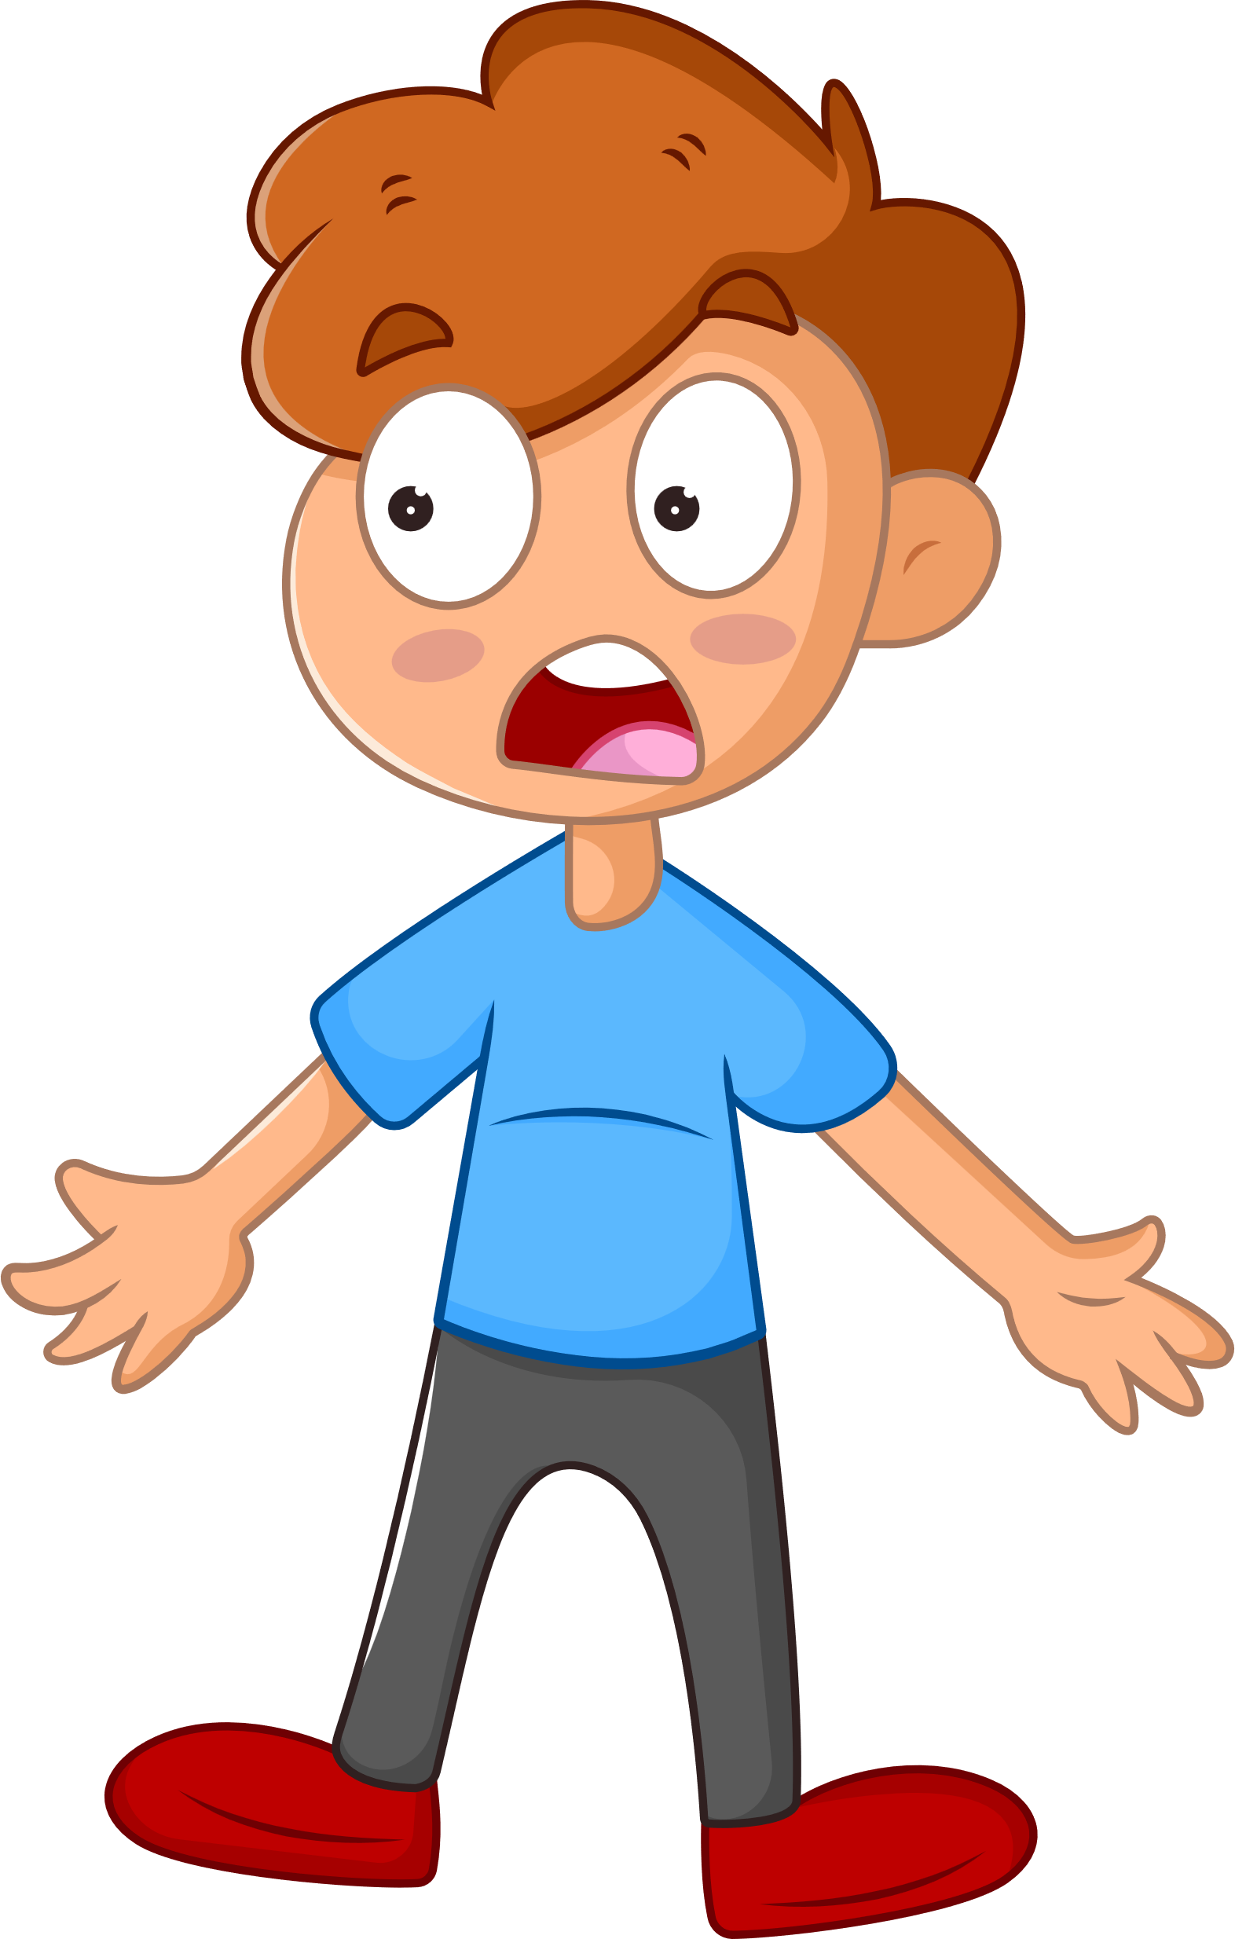

Slide 5
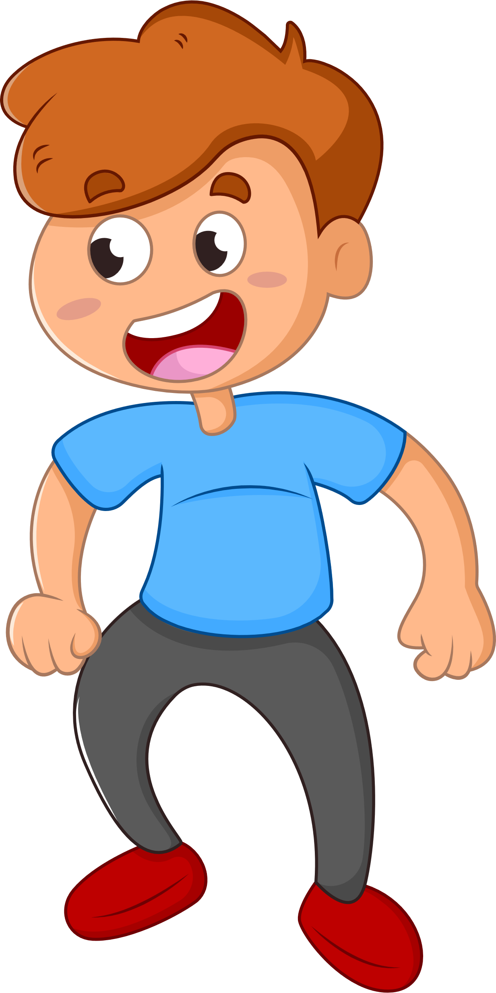

Slide 6
Module: Civic awareness
Sub-module: Everyday active citizenship skills
Topic: Kindness Rock
Resource title: Presentation
Credits: APDNE
2023-1-BG01-KA220-SCH-000160813
All media are within the EU intellectual property law.
Funded by the European Union. Views and opinions expressed are however those of the author(s) only and do not necessarily reflect those of the European Union or the European Education and Culture Executive Agency (EACEA). Neither the European Union nor EACEA can be held responsible for them.

